Slide 1
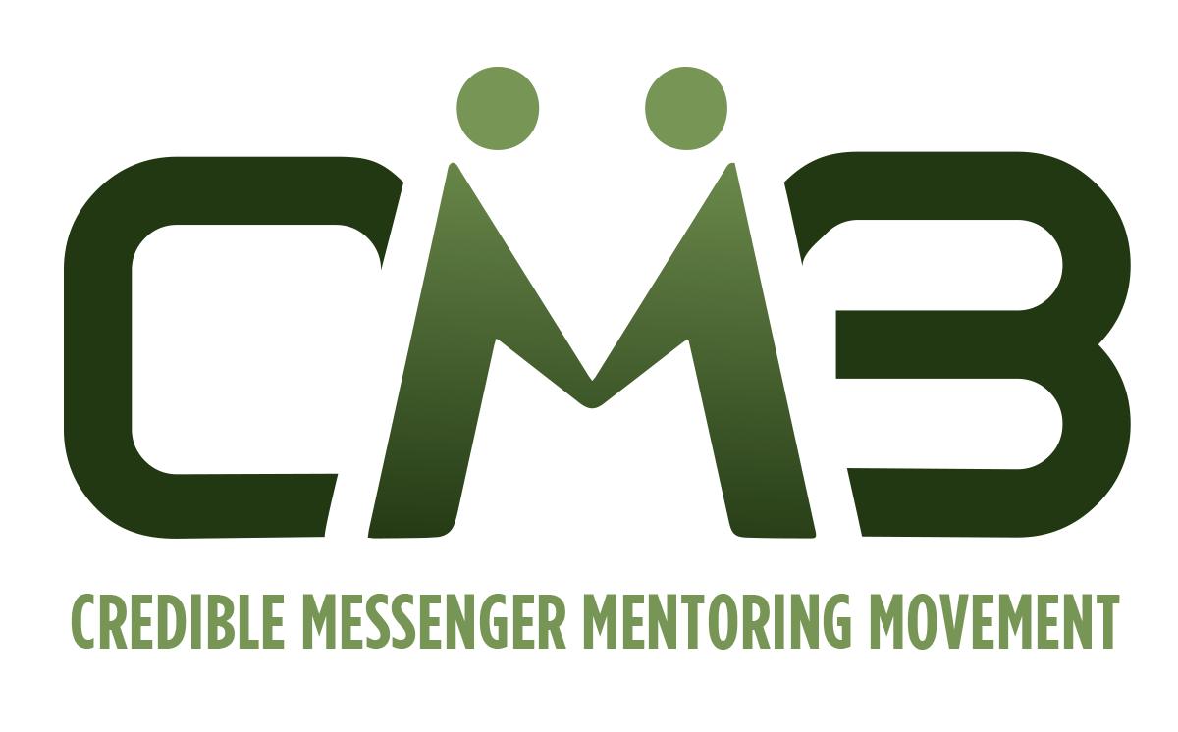

Credible Messenger Mentoring
An Empowerment Model For an Emerging Paradigm
43rd Annual Conference of Agencies and Organizations
Serving Promising Youth
May 9, 2004

Slide 2
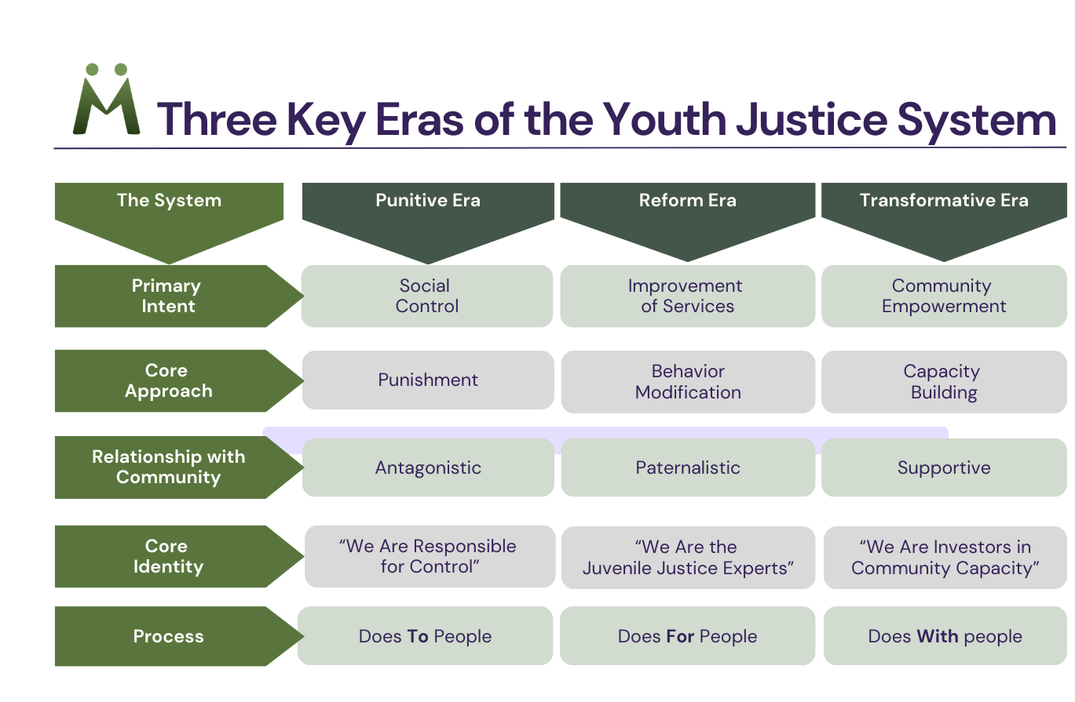

Copyright 2023 by Clinton Lacey

Slide 3

Credible
Messenger
Characteristics
Rooted Natural Leaders
Shared Life Experiences
Proven Track Record of Commitment
Consistent Presence
Inspiring and Impactful Message
Transformative Relationships

Slide 4

Credible Messenger Mentoring Defined
Credible Messengers Practice Transformative Mentoring, which is:
Focused on Healing, Restoration, and Positive Youth Development
Intentional, Structured, Systemic
A Long-Term Commitment
Focused on Transforming Thinking and Behavior
Built upon Healthy, Trusting Relationships
Leverages Trusting Relationships to build and execute plans for ongoing progress and success

Slide 5
History & Evolution of Credible Messenger Mentoring
2013
First Credible Messenger Initiative (Arches – Transformative Mentoring) was implemented at the New York City Department of Probation
2016
Credible Messenger Initiative Implemented and expanded at Washington, DC Department of Youth Rehabilitation Services
2016
Urban Institute and John Jay College of Criminal Justice Conduct Evaluations of Arches (2016) and DC Credible Messenger (2020). The UI study finds an unprecedented 60% recidivism reduction.
2018
National Credible Messenger Convening held in Washington DC involving over 200 justice system leaders, community leaders, funders and researchers.
2018
Various Credible Messenger Initiatives begin Implementation in several other jurisdictions around the nation
2021
Credible Messenger Mentoring Movement (CM3) launched to provide a national program model, comprehensive training, and general assistance to credible messenger practitioners around the nation.

Slide 6
Core Areas of
Credible Messenger Training & Development
Positive Youth Justice Framework
The Art and Science
of Hope
Crisis Intervention & Conflict Resolution
Adolescent Brain Development & the Impact of Trauma
Restorative Justice Practices
Life Path Planning & Fundamentals of Care Coordination
Co-navigating Services, Resources, and Opportunities via Government & Community-based Organizations
Healing Centered Engagement
Individual Transformative Mentoring

Slide 7
Credible Messenger Roles & Responsibilities
Form Trusting Relationships and Lines of Communication with Youth
Provide Individual Transformative Mentoring Sessions
Facilitate Restorative Focused Group Activities
Provide 24/7 Crisis Intervention and Response Services
Provide Life Coaching and Co-navigation Supports
Connection to Services, Resources, and Opportunities via Government and Community-based Organizations
Document Interactions with Youth in Designated Database

Slide 8
Additional
Credible Messenger Roles & Responsibilities in Secure Facilities
Collaborate with agency leadership/staff to examine and develop culture, policy, programs, and practice
Facilitate restorative focused group & individualized activities (independently and in conjunction with designated staff)
Accompany & support youth as they matriculate through their Day/Evening
Participate in relevant staff meetings dealing with case conferencing, planning, youth transition processes, and connections to various services, resources & opportunities for youth in care

Slide 9

Clinton Lacey, President & CEO
Credible Messenger Mentoring Movement
clacey@crediblemessenger3.org
202-341-0261
Thank you

