Slide 1
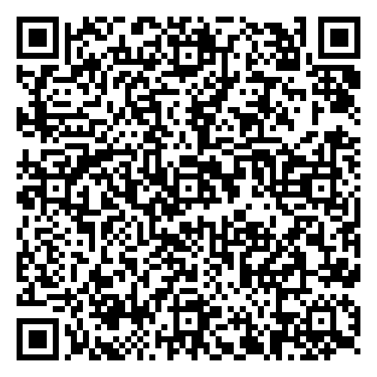

No More Pretend Supports
Aspen Florence Ed.D Candidate
aspen@solutionswc.com

Slide 2

Let us Begin
Think of a service that you currently offer your clients/students…
What is the purpose of that service?
Is it working?
How do you know?
Is it replicable?

Slide 3
Objectives:
1
2
3
Participants will identify their organizations key actions, supports, and interventions
Participants will create a heat map of the development and implementation of each action, support, and intervention
Participants will action plan around best next steps to achieve their desired results with each action, support, and intervention

Slide 4
Norms
Procedures
Engaged
Professional
Human Centered
Action Forward
Active Lecture
Note Taking
Turn and Talk
Action Planning
Notes:
This begins with fostering a culture of empathy and open communication. Our students must understand the impact of their words and actions on others. They must learn to listen actively and express themselves assertively but respectfully.
By teaching conflict resolution, we give our students the tools to recognize and intervene when they witness bullying. Bystanders, often the majority, have the power to put a stop to bullying. We can empower them to be upstanders, not bystanders, by teaching them how to safely and effectively intervene.

Slide 5
Things to think about….
Data Driven- Are we actually using data? Leading and Lagging indicators? Fidelity?
Matching intensity of need to intensity of intervention- Are we willing to implement things that are
more? That require resources?
Fake feel good supports- Is doing something better than nothing? How do we decide?
Worker Burnout- Is offering subpar support or intervention what is actually leading to worker burnout?
Going slow and lighting things on fire: Not enough time to build systems so we continue to respond or
react
Acceleration Trap
Notes:
5 (21)

Slide 6
Accessible
Well Trained, Well Understood, Available
Sustainable
Measureable
Resources and buy-in have been cultivated
Clear and accessible ways to measure progress
Replicable
Written and tracked, not reliant on one person to continue
Systems

Slide 7
Skill Deficits
Acquisition: Hasn’t ever learned the skills, hasn’t used in correctly in desired setting, or hasn’t learned or used the skill since a life changing event.
Solution: Teach, Reinforce, Reteach, Reinforce
Fluency: Has learned the skill and is sufficiently motivated to use it but is awkward in implementation.
Solution: Precorrect, Acknowledge, Prompt, Reinforce, Reteach
Performance: Has learned the skill but is not sufficiently motivated to use it.
Solution: shift the correction reinforcement balance.
Turn and Talk:
How does this apply to you or those you lead?
How does this apply to your clients/Students?
Notes:
10 (123)

Slide 8
Things to Think about
IGNORING/ PUNISHING | LOW SHORT TERM EFFORT HIGH LONG TERM EFFORT LOW LONG-TERM IMPACT
ACCOMMODATING | MEDIUM SHORT TERM EFFORT MEDIUM LONG-TERM EFFORT LOW LONG-TERM IMPACT
SKILL BUILDING | HIGH SHORT TERM EFFORT LOW LONG-TERM EFFORT HIGH LONG-TERM IMPACT
SKILL BUILDING
ACCOMMODATING
IGNORING
/PUNISHING
Notes:
5 minutes (31)

Slide 9
Actions
Support Accommodation
Intervention
Actions are taken as a result of data that indicates a need. They are meant to address performance deficits. Actions do not build skill, do not have a data collection method, and are completed in a 1-2 action time period. Can be useful for performance deficits.
Examples: Meeting, phone call, letter, community partner connection, orientation, consequence, etc.
Support can provide access or grow relationships but does not build skill, usually has no concrete data collection component. Should be short term and used as a space to determine if intervention is needed. Useful for performance deficits.
Examples: Accommodations, altered schedule, 2x10, facilitated conversations,
Interventions address acquisition and fluency deficits. These build student and family skills. They are ongoing, targeted, and have data collection methods. These need to be run with ongoing fidelity checks.
Examples: Tracked goal setting, CICO, Check and Connect, Youth Services Program, Ongoing Therapy, etc.
Actions. Supports, and Interventions can work together to provide a comprehensive program for a client/student.
The goal is to grow clients/students skills and efficacy so they are able to engage in life as a confident contributing citizen. If they are reliant on an action, support, or intervention for too long we are doing them a disservice.

Slide 10
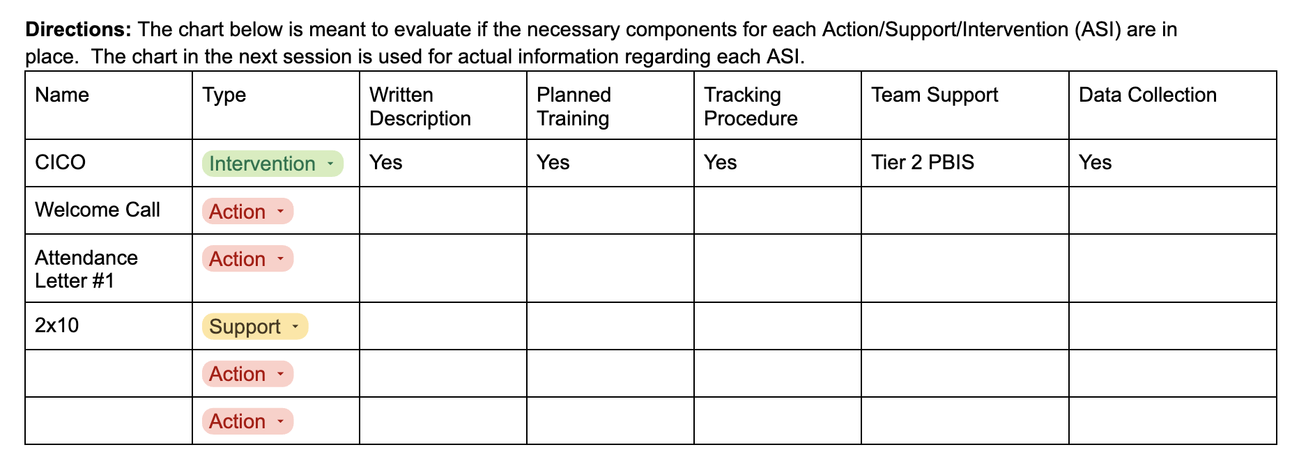

Slide 11
Action/Support/Intervention (ASI) Planning
1
2
3
4
Written Description
Planned Training
Tracking Procedure
Data Collection
This should include the purpose of the ASI, the steps for preparation, implementation, and maintenance. It will be much more intense for an intervention than an action
What is the training modality for this ASI? When is this planned for? How do people access it? Do they need to be trained prior to using it (Intervention is always yes)?
How do we know if this is utilized? How do we communicate that it is being used with relevant stakeholders?
Team Support: Who is the team that “owns” this ASI? The team ensures that the training, coaching, tracking, and data collection occur for this ASI.
Each intervention should have both leading indicators (Fidelity) and lagging indicators (outcomes) that are tracked. The team would evaluate these often to determine the best next steps.

Slide 12



Tools You May Want…
Team Charter
Sample Intervention Description
Systems Implementation Planning Template
Intervention Matrix

Slide 14
Objectives:
1
2
3
Participants will identify their organizations key actions, supports, and interventions
Participants will create a heat map of the development and implementation of each action, support, and intervention
Participants will action plan around best next steps to achieve their desired results with each action, support, and intervention

Slide 15
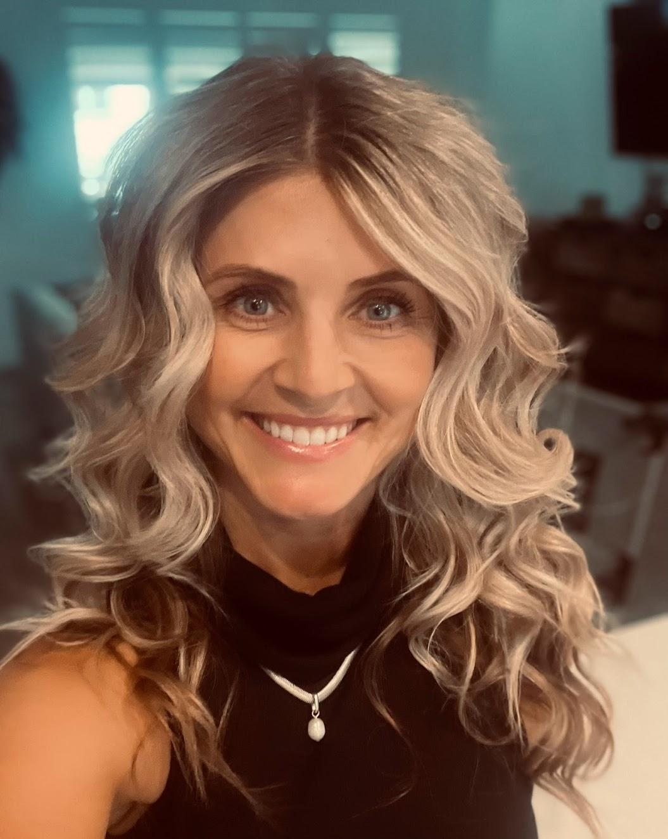
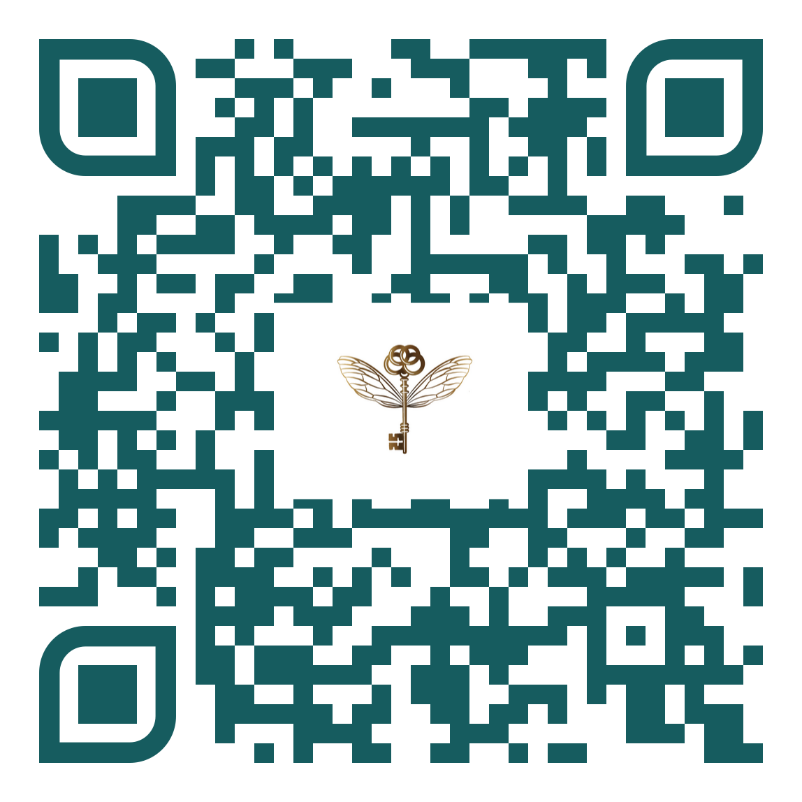
Thank you
Aspen Florence
aspen@solutionswc.com
Solutions Within Consulting

