Slide 1
WELCOME
David Sollami, USBE Education Specialist and Title State Coordinator
Blake Murdoch,Deputy Juvenile Court Administrator
Rachel Edwards, JJYS Community Program Director
Wayne Arner, LCMHC, Utah Youth Village Director of Families First Program
Pamela Vickrey, Utah Juvenile Defender Attorneys Executive Director
Understanding Reintegration Plans. What do they do and how to implement them?

Slide 2
Reintegration Planning
53G-8-213
During the 2023 Legislative Session, Utah passed H.B. 304 [Juvenile Justice Revisions]. This bill initiated new requirements regarding the method for reentry of students who have allegedly committed or committed specific crimes back into the educational setting.
H.B.304 -2023, amended Utah Code § 53G-8-213 providing new guidance for Local Education Agencies (LEAs), Juvenile Justice and Youth Services (JJYS), Utah Courts, and Law Enforcement.
In our 2024 legislative session H.B.84, H.B.362, H.B.418, S.B.246, introduced new guidance and standards.

Slide 3
Overview of Utah Code
53G-8-213
A Local Education Authority (LEA) shall develop a reintegration plan for a student alleged to have committed a violent felony “serious offense” or weapon offense within “5 school days” from the time the letter is sent out.
The school will receive a notification from the juvenile court or a law enforcement agency that a student was arrested for, charged with, or adjudicated in the juvenile court for a violent felony “serious offense” or a weapons offense as defined in Title 76, Chapter 10, Part5, Weapons. (we will include definitions on the contact page)
LEA shall organize a reintegration plan with the “multidisciplinary team,” the student, and the student’s parent or guardian.
The school may deny admission to the student until the school completes the reintegration plan.
The reintegration plan shall address:
a behavioral intervention for the student
a short-term mental health or counseling service for the student; and
an academic intervention for the student

Slide 4
What triggers a Reintegration Plan?
A school district will receive a notification from the juvenile court or a law enforcement agency that a student was arrested for, charged with, or adjudicated in the juvenile court for a violent felony or an offense in violation of Title 76, Chapter 10, Part 5, Weapons, serious offense.
Email notification from the juvenile courts
Notes:
5 school days to complete reintegration plan, a suggestion would not to wait for the student to be released from Detention but to reach out to the detention center/probation officer and make arrangements to go to the detention center to compete the reintegration plan

Slide 5
2024 Legislative Updates
H.B.84, H.B.362, H.B.418, S.B.246
School Safety Specialist and School Safety Director was added to the “multidisciplinary team” -H.B.84
Superintendent’s “designee” was added (singular) -H.B.362
Within 5 “school days” was added -H.B.362
If the serious offense was directed at a school employee or another student within the school, notification of the reintegration plan to that student employee or student and the student’s parent. -H.B.362
An offense that is a violation of Title 76, Chapter 6, Part 4, Theft, and the property stolen is a firearm -H.B.362
A school district may not reintegrate a student into a school where:
Student or staff member has a protective order against the student
Student or staff member is the victim of a sexual crime committed by the student being reintegrated (July 1st) -H.B.362/H.B.418
LEA shall digitally maintain the secure file or, if available, the students related reintegration plan for one year from the day the notice is received and ensure the secure file follows the student if the student transfers to a different school or LEA.-S.B.246
Notes:
Serious offenses towards school employee or student at the school

Slide 6
JUVENILE JUSTICE and YOUTH SERVICES

Slide 7
Juvenile Justice and Youth Service
Youth who are booked into detention on Violent Felony or Weapons Offenses will trigger an email to superintendents.
JJYS has sent 151 emails to superintendents since July 12, 2023.

Slide 8
Juvenile Justice and Youth Services
Dear Superintendent:
You are receiving this notice because a youth in your school district was brought into a juvenile detention center operated by the Division of Juvenile Justice and Youth Services (JJYS), for allegations of having committed a violent felony as defined in Utah Code section 76-3-203.5 or an offense in violation of Utah Code section 76-10-5. This notice is being provided in accordance with Utah Code section 80-6-103 (3). In accordance with this section, we are providing the following information:
The name of the youth. Charlie Brown
The offense for which the youth was taken into temporary custody, or admitted to detention. Aggravated assault
If available, the name of the alleged victim if the alleged victim resides in the same school district as the youth or attends the same school as the youth.
What you can expect:
In the coming days you will also receive a notice from the Juvenile Court.
The notice received from the Juvenile Court is the notice which triggers the “reintegration plan” described in Utah Code section 53G-8-213.
In creating the reintegration plan for the youth, you are required to include a representative from the Juvenile Court as well as JJYS on the multidisciplinary team.
In the notice you receive from the Juvenile Court, you will be provided a link which will contain instructions on how to make contact with the appropriate Juvenile Court and JJYS personnel to join the team.
PLEASE NOTE:
The presenting youth was brought into a juvenile detention center for allegations of having committed a violent felony as defined in 76-3-203.5 or an offense in violation of 76-10-5. This youth is assumed innocent until the allegations against them are proven true beyond a reasonable doubt.
The information indicating the school district where a youth is enrolled was provided by the youth themselves. If this youth is not in fact enrolled in your School District, please email Trina Dickinson (JJYS Program Director, Office of Youth Services) at tdickinson@utah.gov.

Slide 9

Letters sent to schools by the Juvenile Court
Utah Code 80-6-103
Notification of Adjudication
(6) (a) If the juvenile court adjudicates a minor for serious offense, the juvenile court
shall order a juvenile probation officer to notify a school official, or a transferee
school official, of the adjudication.
(b) A notification under this Subsection (6) shall be given to a school official, or a
transferee school official, within three days after the day on which the minor
Is adjudicated.
(c) A notification under this section shall include:
(i) the name of the minor;
(ii) the offense for which the minor was adjudicated; and
(iii) if available, the name of the victim if the victim:
(A) resides in the same school district as the minor; or
(B) attends the same school as the minor.

Slide 10
Letters sent to schools by the Juvenile Court
Utah Code 80-6-103
Probation Notification
(7) If the juvenile court orders probation under Section 80-6-702, the juvenile court shall order a juvenile probation officer to notify the appropriate local law enforcement agency and the school official of the juvenile court's order for FORMAL probation
Detention Notification
(4) After a detention hearing for a minor who is alleged to have committed serious offense as defined in 80-6-103, the juvenile court shall order a juvenile probation officer to notify a school official, or a transferee school official, and the appropriate local law enforcement agency of the juvenile court's decision, including any disposition, order, or no-contact order.

Slide 11
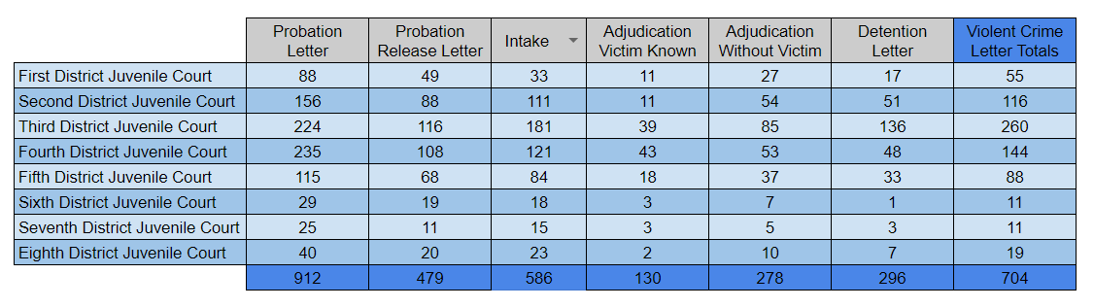
Letters by Judicial District

Slide 12
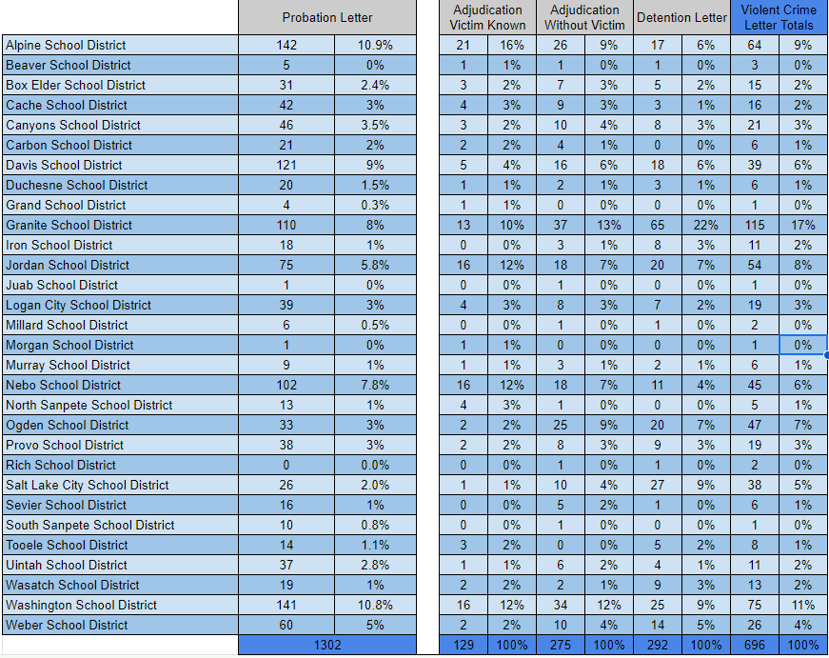
Letters by School District

Slide 13
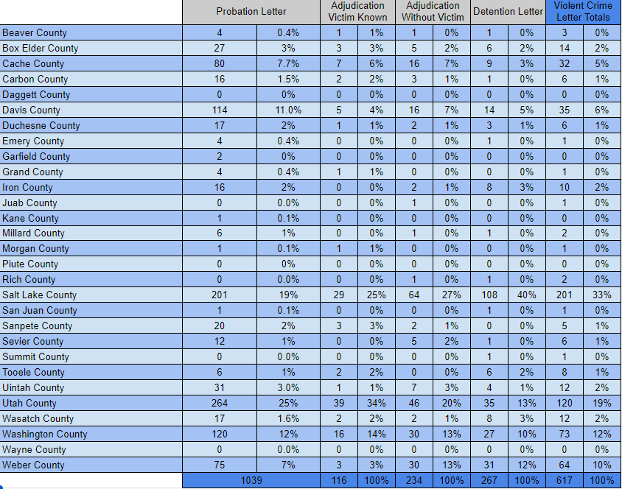
Letters by County

Slide 14
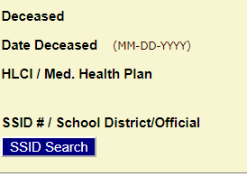
CARE / UTREX Interface
The Juvenile Court system (CARE) can now access UTREX enrollment information directly. This will allow the AOC to send letters based on current enrollment.

Slide 15
CARE / UTREX Interface
If you get a notification letter for a youth not enrolled in your school district, please notify any of the following people:
Dave Sollami, david.sollami@schools.utah.gov
Benji Carrier, benjamin.carrier@schools.utah.gov
Blake Murdoch, blakem@utcourts.gov
Destyni Upton, destyniu@utcourts.gov

Slide 16
Email Body: Probation Notification
Superintendent or designee,
This letter is to notify you that a youth who may attend your school has been placed on probation by the Court as required by statute. This DOES NOT trigger a reintegration plan. It is informational only. Contact information of the assigned probation officer can be found below if you have any questions.
Assigned Probation Officer: PO Name
Assigned Probation Officer Email: PO Email
Assigned Probation Officer Phone: PO Phone

Slide 17
Email Body: Serious Offense Notification
Superintendent,
This notice is to inform you that a detention hearing was conducted on behalf of Billy Kiddo for allegations of committing a violent felony as defined in Utah Code Section 76-3-203.5 or an offense in violation of Utah Code Section 76-10-5. This youth is assumed innocent until the allegations against them are proven true beyond a reasonable doubt.
This notice requires you to take action. To support you in your required action, the Administrative Office of the Courts and the Utah State Board of Education developed this email, which you may send to your school, with the required notification letter. This link provides contact information of probation leadership teams for each of the judicial districts, and this link provides the same for JJYS teams (this will take you to a webpage, click on the search field and a drop-down will appear. Select "School Reintegration" and then click your county). If there is an assigned probation officer associated with this case, you will find the contact information of that officer at the end of this email. The following is information that the Utah State Board of Education recommends you include in your email to the school.
Per Utah Code Section 53G-8-213, this notice triggers your LEAs responsibility to begin development of a reintegration plan for said student, within 5 days of the receipt of this notification. This reintegration plan must be developed by a multidisciplinary team and must include elements that address:
Behavioral interventions
Short-term mental health or counseling
Academic interventions

Slide 18
Email Body: Serious Offense Notification
Your multidisciplinary team may include those you feel are important to the student's reintegration success but must also include:
Parent and student
LEA
Juvenile Court
Division of Juvenile Justice and Youth Services
School Resource Officer (if applicable)
Any additional relevant party
The LEA may only deny admission to the student prior to the 5th day or development of the reintegration plan, whichever comes first.
We encourage you to utilize a Restorative Practices approach when developing your students' reintegration plan. An effective reintegration plan includes providing them with a mentor that can assist with their transition. Utah is a full implementation state of Check and Connect which is evidence-based in engagement and reducing student dropout. USBE can provide training and support for Check and Connect mentors through Youth in Care or Through Prevention. Additional resources to assist you in developing a reintegration plan can be found in the Transition Toolkit 3.0 of the National Technical Assistance Center for the Education of Neglected or Delinquent Children and Youth.
If you need assistance with resources or support in developing your student reintegration plan, please contact: PreventionandStudentServices@schools.utah.gov
Assigned Probation Officer: PO Name
Assigned Probation Officer Email: PO Email
Assigned Probation Officer Phone: PO Phone

Slide 19
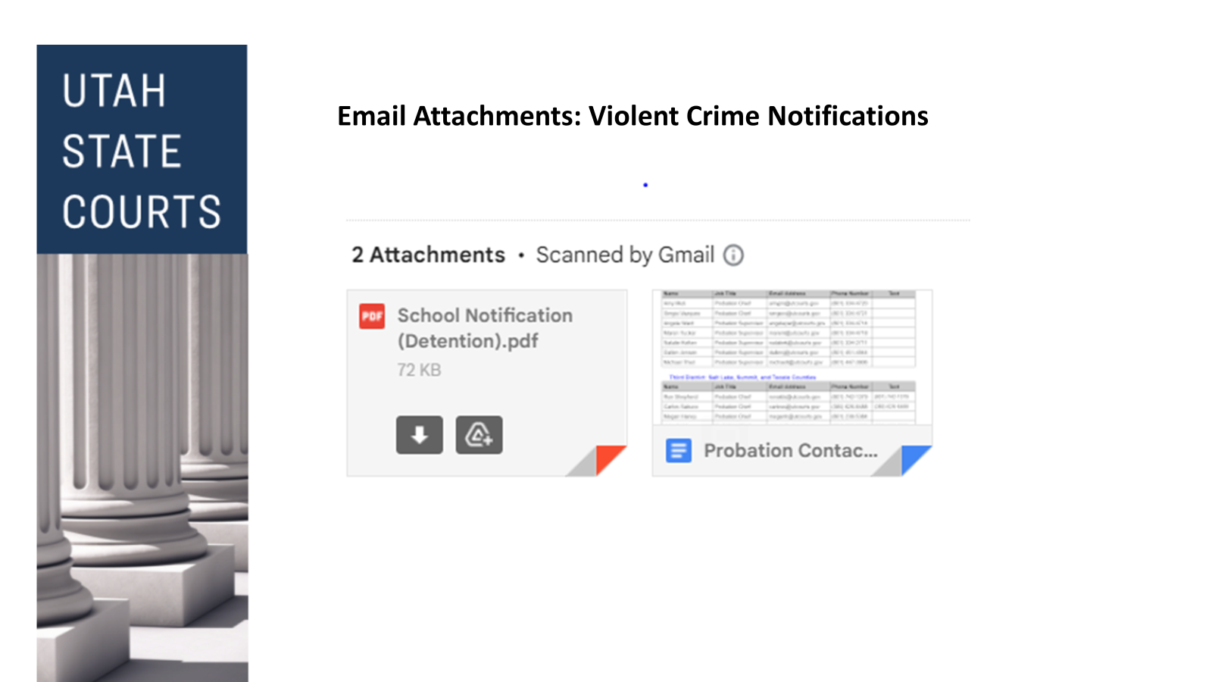

Slide 20
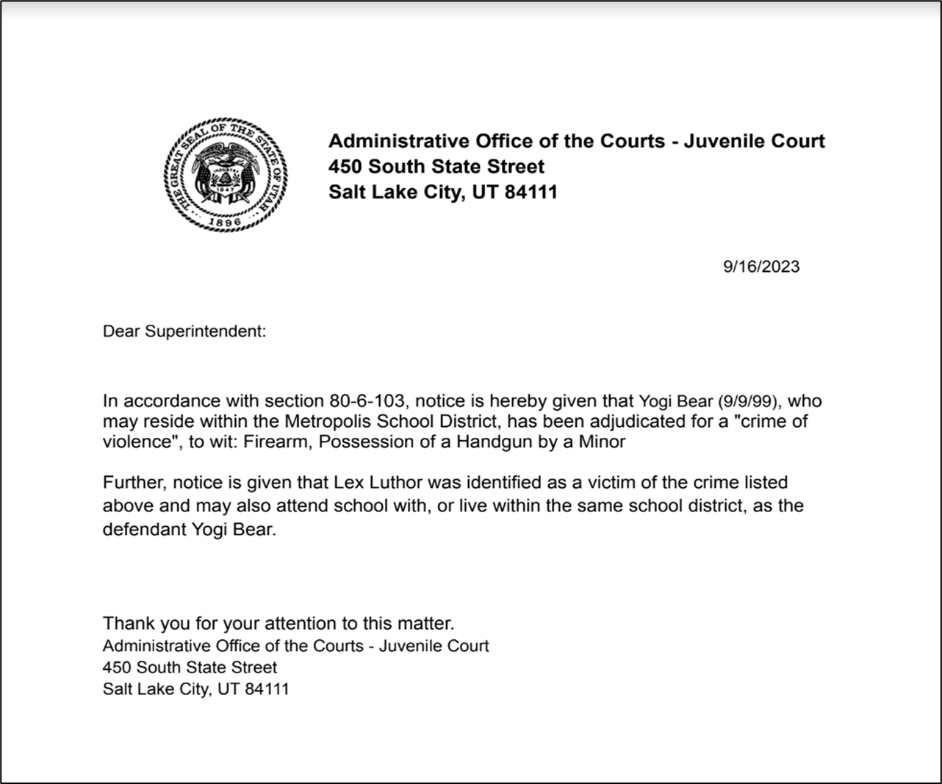

Slide 21
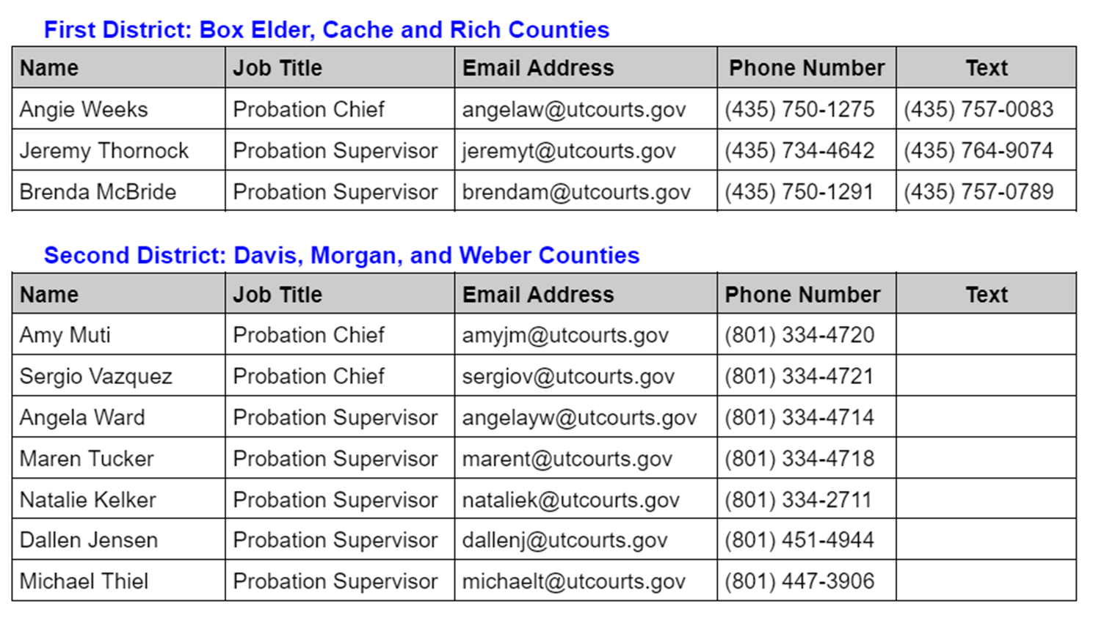
Probation Contact List

Slide 22
Juvenile Court Contacts
Administrative Office of the Courts
Sonia Sweeney
Juvenile Court Administrator
sonias@utcourts.gov
Blake Murdoch
Deputy Juvenile Court Administrator
blakem@utcourts.gov
(801) 578-3811
Destyni Upton
Program Coordinator
destyniu@utcourts.gov
(801) 238-5408

Slide 23
Multidisciplinary Team
Local Education Authority (LEA)
Juvenile Court (Probation Officer)
Division of Juvenile Justice and Youth Services
School Safety and Security Specialist
School Safety and Security Director
School Resource Officer if applicable
Any relevant party that should be involved in a reintegration plan (student,parent, guardian)
Notes:
We have sent out an updated template for reintegration planning, with the 2024 legislative updates
In the email that is sent out by Juvenile Courts there are links for both probation and Juvenile Justice that will take you to a page where you can look up your local contact for these planning meetings. Those links can also be found in the toolkit provide earlier this year

Slide 24
Meeting Requirements
The meeting shall address the following:
A behavioral intervention for the student
A short-term mental health or counseling service for the student
An academic intervention for the student
Notes:
We will be sending out invites for our Superintendents, Charter Directors and Designee for August 21st at 3:00pm we will hold a zoom meeting for questions and answers around reintegration planning.

Slide 25
Juvenile Justice and Youth Services
Juvenile Justice Website https://jjys.utah.gov/
Youth Services can provide:
Individualized youth and family plan with comprehensive access to services
Standardized model through the state with a single hub to streamline all early intervention services
Screening and assessment to accurately identify youth and family strengths and needs
Ability to procure services based on youth and family needs

Slide 26
Juvenile Justice and Youth Services
Desired outcome:
Keep youth safely in their homes, schools and communities
Early screening of a youth and family strength and needs
Connect youth and families to appropriate services in the community

Slide 27
Juvenile Justice and Youth Services
Youth Service Model
Refer-Whether you are a parent, law enforcement, court, or school, our online referral process makes it simple for youth ages 10-18, primarily in need of services due to the child's behavior to get the support they need. Someone from Youth Services will respond to the referral within 48 business hours of submission.
Screen-Accurate screenings are key in determining the right service for the youth at the earliest time. When a referral is made to Youth Services, counselors will assist the youth and family by asking a series of simple screening questions to find out if there are any immediate concerns while working to resolve any current crisis.
Assess-Validated assessment tools are utilized for evidence-based, data-driven decisions and interventions that look at youth and family strengths and needs, and what strategies will best achieve a positive outcome.

Slide 28
Juvenile Justice and Youth Services
Youth Service Model
Plan-A Youth and Family Plan is developed that is strength based and guided by the youth, with an emphasis on family voice.
Follow Up-Transition is key to successful outcomes. Follow up provides support to the youth and family while assisting to maintain connection to community resources.

Slide 29
A Probation Officer’s Guide to Collaboration With Schools
When notice from the Juvenile Court is sent to a school official, either to inform the school of a violent crime allegation/adjudication (Utah Code Section 53G-8-213) or to inform the school that a youth has been placed on probation (Utah Code Section 80-6-103), the school and probation officer become collaborators in addressing high-risk behavior. (See Utah Code Section 53G-8-211). This guide was developed by the Administrative Office of the Courts in collaboration with the Utah State Board of Education to help inform probation officers and local education agencies regarding information that can be shared with school officials by probation officers in the development of a reintegration plan or during interactions about youth who are under court jurisdiction.
Pursuant to the Utah Code of Judicial Administration (UCJA Rule 4-202.03), public or private individuals or agencies providing services to the subject of record may access juvenile court social records if a probation officer determines that access is necessary to provide effective services. Utah statute further allows the juvenile court to share “personally identifiable student data to improve education outcomes for youth” who are under the jurisdiction of the Utah Juvenile Court (Utah Code Section 53E-9-308).

Slide 30
A Probation Officer’s Guide to Collaboration With Schools
It would be difficult for a school to collaborate with probation and provide effective services to youth who are under court jurisdiction without knowing what risk items most contribute to the youth's high-risk behaviors. To help the school provide effective services for youth who are under court jurisdiction, probation officers may discuss and share a youth’s case plan and PRA/PSRA information with local education agencies. Probation officers should be prepared to share the following information:
1. Any information provided in notification letters as outlined in Utah Code Section 80-6-103;
2. Redacted court orders for youth under court jurisdiction if the order pertains to the youth’s
academic performance (e.g. grades and attendance);
3. General information about community resources that may assist in addressing a youth’s
high-risk behavior;
4. If available, risk items determined to be most impactful to a youth’s high-risk behavior as
determined by the Protective and Risk Assessment (PRA) for moderate or high-risk youth;
5. If available, action steps and goals included in a case plan;
6. If available, interventions used to address risk items determined by the PRA.

Slide 31
A Probation Officer’s Guide to Collaboration With Schools
A probation officer should make efforts to strengthen a youth’s community support by helping schools understand how risk items are being addressed. The probation officer should collaborate with the school to identify ways in which meaningful incentives could be provided to the youth. For example, a probation officer may share current assignments given to a youth from Alternative Response Training (ART) or Families First, and discuss how the school may recognize and reward the use of a certain skill. A probation officer may also share specific service delivery efforts that are being offered to the youth, such as Carey Guides, so the local education agency may effectively assess ways in which to provide services to youth who are under court jurisdiction in more meaningful ways.

Slide 32
Problematic Sexual Behavior & Safety
The goal is to keep children safe. We all agree on this.
However, do we notice how gun crimes are linked to problematic sexual behavior (psb)?
Often youth with the broad label of problematic sexual behavior (psb) are lumped into categories of violent crime and viewed as similar to gun violence.
Most experts and clinicians working with children and adolescents with psb readily acknowledge the harm that these behaviors cause and advocacy for them is not intended to minimize this harm.
More effort is needed to understand the CONTEXT that they behaviors occurred.

Slide 33
Research-based Decision Making
In a recent meta-analysis by Patrick Lussier, Ph.D (2023) of all sexual recidivism studies between 1940-2019, the rate of sexual recidivism was 8% with close to 60,000 participants.
With such low recidivism rates, it is CRITICAL to identify and build upon protective factors.
Keeping children and adolescents socially engaged and supervised by adults in pro-social activities are both major protective factors from school.
Long suspensions, shaming or guilt inducing consequences, or the social isolation of online school formats actually increase a youth risk factors.

Slide 34
Understanding the Context of a Child's Needs
Understanding the context in which a psb occurred in is critical to individualizing a reintegration plan.
Compare:
A 15 year-old male, charged with forcible sexual abuse or rape of a child, following the sexual abuse of a younger 6 year-old sibling. Does the 15 year old have a learning disability, ASD, or other social impairment? Was this a repetitive act or a 1 time incident? Is being around high-school aged youth actually a protective factor?
VS.
A 16 year-old male with no developmental issues committing an aggravated sexual assault of a 16 year-old female peer that goes to the same school.
Understanding the contextual nature of these two different scenarios is critical. It allows everyone involved to make informed safety decisions that are in everyone's best interest.

Slide 35
The Best Practice Standard in Utah
Taken from the 2024 NOJOS Protocols & Standards Manual,
“The sex-specific treatment approach must be sensitive to the youth’s developmental trajectory and how experience, development, environment, differing ability, society, and culture impact this trajectory and create dynamics, issues, and problems that divert the youth on a pathway to engage in problematic sexual behaviors and/or sexually abusive behaviors. Most adolescents can be safely treated in community settings.” (ATSA 2017)

Slide 36
The Best Practice Standard in Utah
As taken from the Utah Network on Juvenile Obtaining Safety (NOJOS) 2024 Protocols & Standards Manual,
“Moreover, a strength-based approach is strongly recommended given that protective factors can have a great impact on decreasing risk and helping the youth in making healthy life choices. Indeed, strengths-based factors help keep youth and their families positively engaged while mitigating risk factors and promoting healthy, prosocial ways for getting needs met, which are all essential components for effective treatment services.” ATSA Juvenile Practice Committee, September 2020.
Invite the clinician or NOJOS expert to help understand these needs while mitigate risk factors.

Slide 37
You're not stuck.
You’re just committed to certain patterns of behavior because they have helped you in the past. Now those behaviors have become more harmful than helpful. The reason why you can’t move forward is because you keep applying an old formula to a new level in your life. Change the formula to get a different result
-Emily Maroutian

Slide 38
Resources and Links to the Reintegration Planning Presentation
53G-8-213
H.B.84 School Safety Amendments
H.B.362 Juvenile Justice Revisions
H.B.418 Student Offender Reintegration Amendments
S.B. 246 Juvenile Justice Modifications
Part 5 Weapons Definitions
Violent Felony “serious offenses” Definitions
More information please contact:
Utah State Board of Education: David Sollami, david.sollami@schools.utah.gov
Juvenile Court: Blake Murdoch, blakem@utcourts.gov
Juvenile Court email notifications: Destyni Upton, destyniu@utcourts.gov
Juvenile Justice and Youth Services: Rachel Edwards, redwards@utah.gov

Slide 39
QUESTIONS
David Sollami, david.sollami@schools.utah.gov
Blake Murdoch, blakem@utcourts.gov
Rachel Edwards, redwards@utah.gov
Wayne Arner, warner@youthvillage.org
Pamela Vickrey, pvickrey@ujda.org

