Slide 1
WELCOME
Understanding Utah Law on Reintegration Plans

Slide 2
Reintegration Planning
Utah Code: 53G-8-213
During the 2023 Legislative Session, Utah passed H.B. 304 [Juvenile Justice Revisions]. This bill initiated new requirements regarding the method for reentry of students who have allegedly committed specific crimes back into the educational setting.
Lead: School District Superintendent/Designee
Supportive Agency/Technical Assistance for LEA: Utah State Board of Education
Supportive Agency: Juvenile Court
Supportive Agency: Juvenile Justice and Youth Services

Slide 3
Overview of Utah Code
53G-8-213
A “school district” shall develop a reintegration plan for a student alleged to have committed a serious offense or weapon offense within “5 school days” from the time the letter is sent out.
If a school district receives a notification from the juvenile court or a law enforcement agency that a student was arrested for, charged with, or adjudicated in the juvenile court for a serious offense, the school shall develop a reintegration plan for the student with a multidisciplinary team, the student, and the student's parent or guardian, within five school days after the day on which the school receives a notification.
The school may deny admission to the student until the school completes the reintegration plan.
The reintegration plan shall address:
a behavioral intervention for the student
a short-term mental health or counseling service for the student; and
an academic intervention for the student
If the serious offense was directed at a school employee or another student within the school, notification of the reintegration plan to that school employee or student and the student's parent

Slide 4
(5) A school district may not reintegrate a student into a school where:
(a) a student or staff member has a protective order against the student being reintegrated; or
(b) a student or staff member is the victim of a sexual crime or forcible felony committed by the student being reintegrated.
(6)
(a) Notwithstanding Subsection (2), a school district may elect to not integrate a student into a school if the student has committed, or allegedly committed, a forcible felony.
(b) If a school district elects to not integrate a student under Subsection (6)(a), the school district shall provide alternative education options for the student.

Slide 5
What triggers a Reintegration Plan?
A school district will receive a notification from the juvenile court or a law enforcement agency that a student was arrested for, charged with, or adjudicated in the juvenile court for a serious offense or an offense in violation of Title 76, Chapter 10, Part 5, Weapons.
Email notification from the juvenile courts to the superintendent or designee
Notes:
5 school days to complete reintegration plan, a suggestion would not to wait for the student to be released from Detention but to reach out to the detention center/probation officer and make arrangements to go to the detention center to compete the reintegration plan

Slide 6
Juvenile Justice and Youth Service

Slide 7
Juvenile Justice and Youth Service
Youth who are booked into detention on Serious Offenses or Weapons Offenses will trigger an email to superintendents.
JJYS has sent 478 emails to superintendents since July 12, 2023.

Slide 8
Juvenile Justice and Youth Services
Dear Superintendent:
You are receiving this notice because a youth in your school district was brought into a juvenile detention center operated by the Division of Juvenile Justice and Youth Services (JJYS), for allegations of having committed a violent felony as defined in Utah Code section 76-3-203.5 or an offense in violation of Utah Code section 76-10-5. This notice is being provided in accordance with Utah Code section 80-6-103 (3). In accordance with this section, we are providing the following information:
The name of the youth. Charlie Brown
The offense for which the youth was taken into temporary custody, or admitted to detention. Aggravated assault
If available, the name of the alleged victim if the alleged victim resides in the same school district as the youth or attends the same school as the youth.
What you can expect:
In the coming days you will also receive a notice from the Juvenile Court.
The notice received from the Juvenile Court is the notice which triggers the “reintegration plan” described in Utah Code section 53G-8-213.
In creating the reintegration plan for the youth, you are required to include a representative from the Juvenile Court as well as JJYS on the multidisciplinary team.
In the notice you receive from the Juvenile Court, you will be provided a link which will contain instructions on how to make contact with the appropriate Juvenile Court and JJYS personnel to join the team.
PLEASE NOTE:
The presenting youth was brought into a juvenile detention center for allegations of having committed a violent felony as defined in 76-3-203.5 or an offense in violation of 76-10-5. This youth is assumed innocent until the allegations against them are proven true beyond a reasonable doubt.
The information indicating the school district where a youth is enrolled was provided by the youth themselves. If this youth is not in fact enrolled in your School District, please email Trina Dickinson (JJYS Program Director, Office of Youth Services) at: tdickinson@utah.gov.

Slide 9



Slide 10
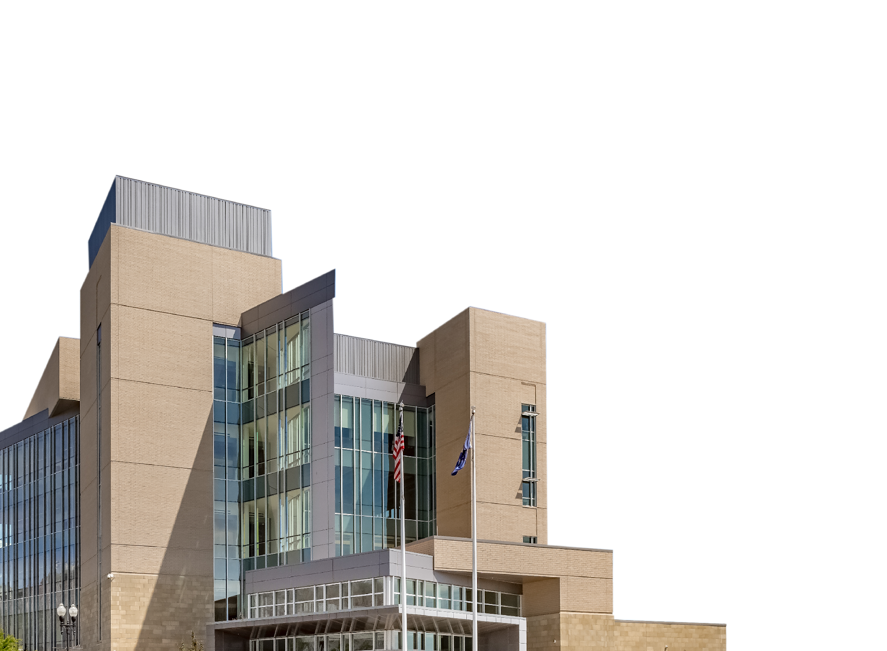
Juvenile Court Notification Letters Requiring Reintegration Plan
Adjudication Letters
Detention Letters
Letters sent for Serious Offenses and Weapons Offenses
Adjudication hearing in front of assigned judge
Booked in detention and initial hearing held
Victim Information included in Adjudication Letters IF Victim resides in the same school district
Three types of reports are pulled with case information
Three types of reports are pulled with case information
Utah Code 80-6-103
letters sent to school district and PO
letters sent to school district, law enforcement, and PO

Slide 11

Juvenile Court Notification Letters NOT Requiring Reintegration Plan
Probation Letters
Released from Probation Letters
Letters sent for formal probation
Disposition, youth is placed on probation
Probation Review Hearing
v
Three types of reports are pulled with case information
Three types of reports are pulled with case information
Utah Code 80-6-103
Letters sent to school, law enforcement, and PO
Letters sent to school, law enforcement, and PO

Slide 12
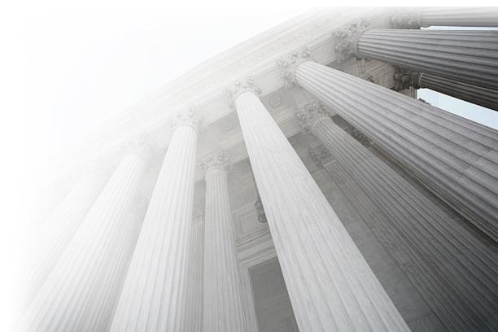
Sexual Offenses described as a serious offense that trigger a notification from the Juvenile Court
Utah Code 76-3-203.5
Rape as described in Section 76-5-402
Rape of a child as described in Section 76-5-402.1
Object rape as described in Section 76-5-402.2
Object rape of a child as described in Section 76-5-402.3
Forcible sodomy as described in Section 76-5-403
Sodomy on a child as described in Section 76-5-403.1
Forcible sexual abuse as described in Section 76-5-404
Sexual abuse of a child as described in Section 76-5-404.1
Aggravated sexual abuse of a child as described in Section 76-5-404.3
Aggravated sexual assault as described in Section 76-5-405
Sexual exploitation of a minor as described in Section 76-5b-201
Aggravated sexual exploitation of a minor as described in Section 76-5b-201.1
Sexual exploitation of a vulnerable adult as described in Section 76-5b-202
Aggravated exploitation of prostitution as described in Subsection 76-5d-208(2)(a)
Each of these offenses are felony level

Slide 13

Sexual Offenses NOT described as serious offense and will NOT trigger notification from the Juvenile Court
Utah Code 76-3-203.5
The "violent felony" offense defined in Subsection (1)(c) does not include any felony sexual offense violation of:
(A) enticing a minor, Section 76-5-417;
(B) lewdness, Section 76-5-419; or
(C) lewdness involving a child, Section 76-5-420.
Any sexual offense that is charged as, or amended to, a misdemeanor level.
Any sexual offense held in abeyance.

Slide 14
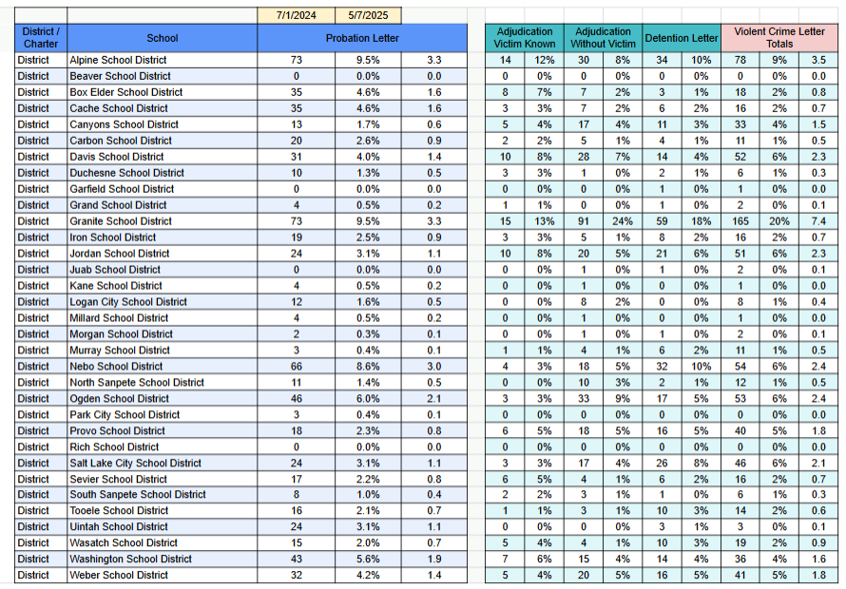
Letters by School District

Slide 15
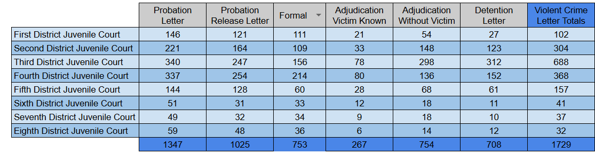

Letters by Judicial District

Slide 16
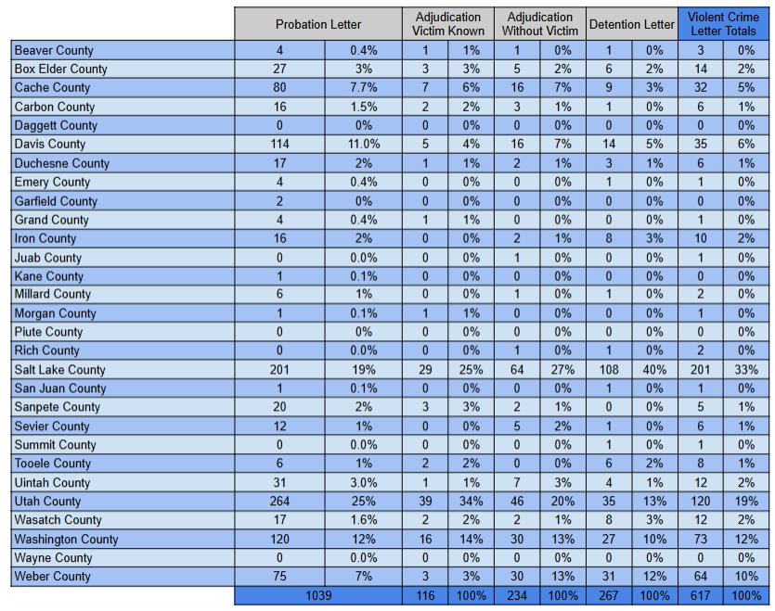
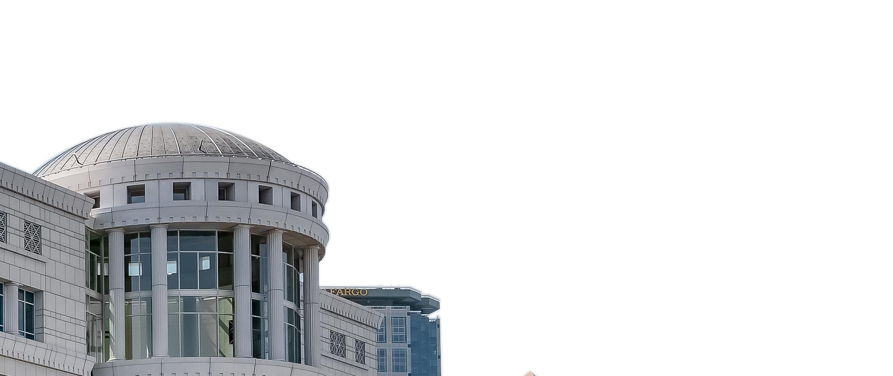
Letters by County

Slide 17
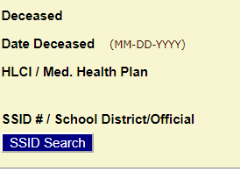
CARE / UTREX Interface
The Juvenile Court system (CARE) can now access UTREX enrollment information directly. Probation Officers have access to this. The AOC has a direct SSID login that is used to look up most current enrollment information
Dropped out/unenrolled youth: Letters sent to school district within which the youth resides
Youth placed in Residential Treatment Centers: Letter sent to school district within which the RTC resides

Slide 18
Contact Information for Enrollment
If you get a notification letter for a youth not enrolled in your school district, please notify any of the following people:
David Sollami, david.sollami@schools.utah.gov
Benji Carrier, benjamin.carrier@schools.utah.gov
Blake Murdoch, blakem@utcourts.gov
Destyni Upton, destyniu@utcourts.gov

Slide 19
Contact Information for Probation Officers and JJYS within email body of notifications
Your multidisciplinary team may include those you feel are important to the student's reintegration success but must also include:
Parent and student
LEA (Both the School Safety and Security Specialist (every campus) and the School Safety and Security Director (every LEA) are on the multi-disciplinary team)
Juvenile Court (Probation Officer Email)
Division of Juvenile Justice and Youth Services (ssherrow@utah.gov, jljoe@utah.gov)
School Resource Officer (if applicable)
Any additional relevant party
The LEA may only deny admission to the student before the 5th day or development of the reintegration plan, whichever comes first.
We encourage you to utilize a Restorative Practices approach when developing your students' reintegration plan. An effective reintegration plan includes providing them with a mentor that can assist with their transition. Utah is a full implementation state of Check and Connect which is evidence-based in engagement and reducing student dropout. USBE can provide training and support for Check and Connect mentors through Youth in Care or Through Prevention. Additional resources to assist you in developing a reintegration plan can be found in the Transition Toolkit 3.0 of the National Technical Assistance Center for the Education of Neglected or Delinquent Children and Youth.
If you need assistance with resources or support in developing your student reintegration plan, please contact PreventionandStudentServices@schools.utah.gov. If unable to reach a probation officer, you may contact Blake Murdoch, Deputy Juvenile Court Administrator, at blakem@utcourts.gov or Destyni Upton, Program Coordinator, at destyniu@utcourts.gov. If you unable to reach a JJYS Case Manager, you may contact Rachel Edwards, Program Director, at redwards@utah.gov. You may also contact Dave Sollami with the USBE with any questions regarding reintegration plans.
Assigned Probation Officer: Name
Assigned Probation Officer Email: Email

Slide 20
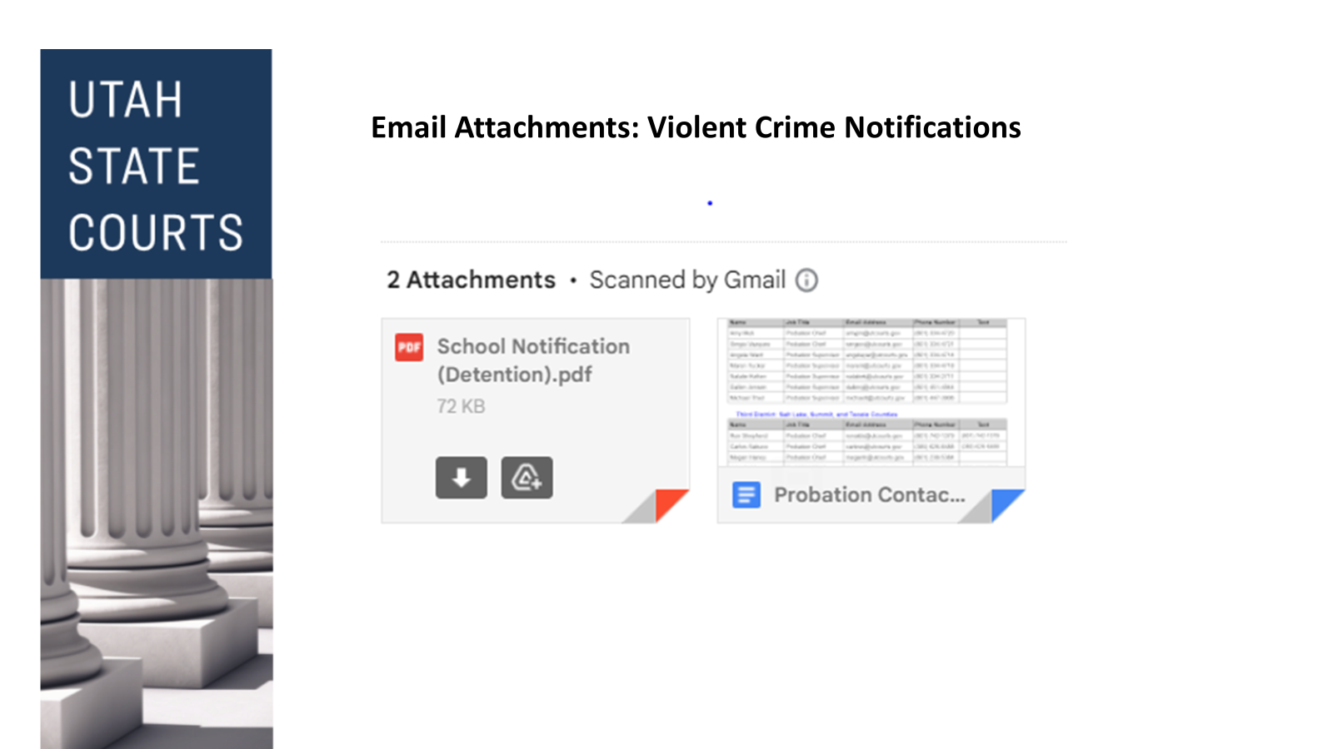
Attachments included in notification email

Slide 21
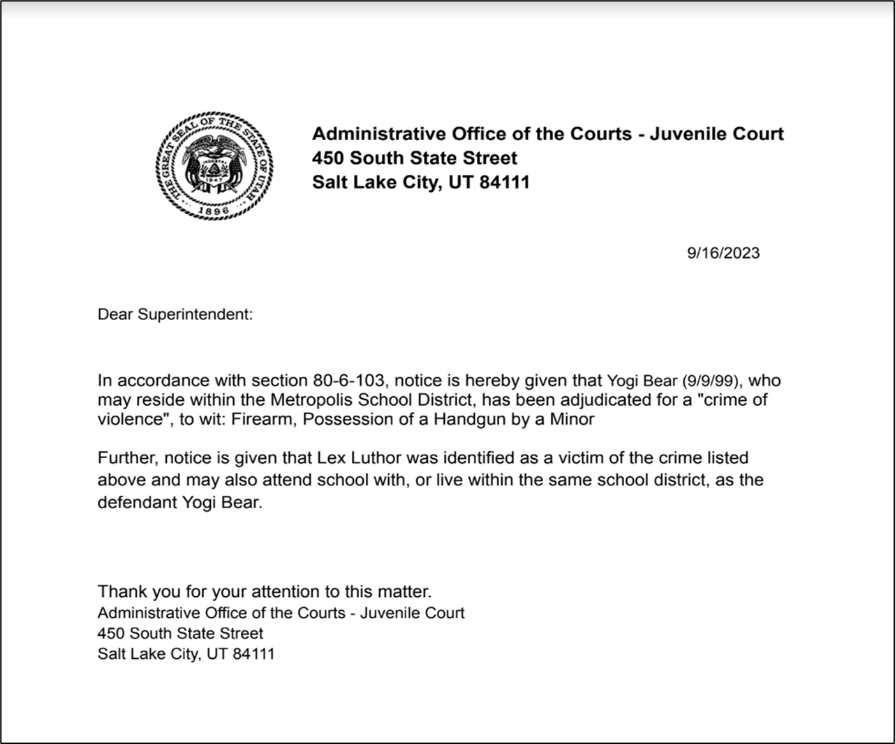
Notification letter example

Slide 22
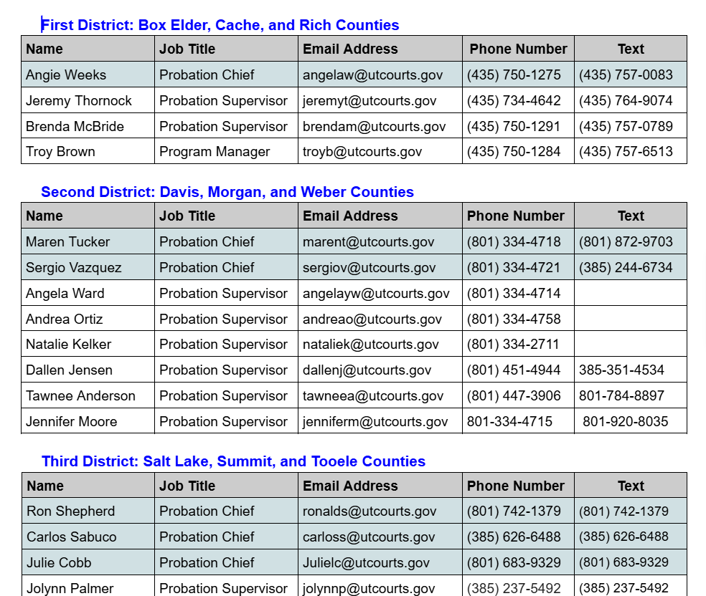
Probation Contact List

Slide 23
Administrative Office of the Courts
Sonia Sweeney
Juvenile Court Administrator
sonias@utcourts.gov
Blake Murdoch
Deputy Juvenile Court Administrator
blakem@utcourts.gov
Destyni Upton
Program Coordinator
destyniu@utcourts.gov

Slide 24
Multidisciplinary Team
Local Education Authority (LEA)
Juvenile Court (Probation Officer)
Division of Juvenile Justice and Youth Services
School Safety and Security Specialist
School Safety and Security Director
School Resource Officer if applicable
Any relevant party that should be involved in a reintegration plan (student,parent, guardian)
Notes:
We have sent out an updated template for reintegration planning, with the 2024 legislative updates
In the email that is sent out by Juvenile Courts there are links for both probation and Juvenile Justice that will take you to a page where you can look up your local contact for these planning meetings. Those links can also be found in the toolkit provide earlier this year

Slide 25
Meeting Requirements
The meeting shall address the following:
A behavioral intervention for the student
A short-term mental health or counseling service for the student
An academic intervention for the student
Notes:
We will be sending out invites for our Superintendents, Charter Directors and Designee for August 21st at 3:00pm we will hold a zoom meeting for questions and answers around reintegration planning.

Slide 26
Juvenile Justice and Youth Services
Juvenile Justice Website https://jjys.utah.gov/
Youth Services can provide:
Individualized youth and family plan with comprehensive access to services
Standardized model through the state with a single hub to streamline all early intervention services
Screening and assessment to accurately identify youth and family strengths and needs
Ability to procure services based on youth and family needs

Slide 27
Juvenile Justice and Youth Services
Desired outcome:
Keep youth safely in their homes, schools and communities
Early screening of a youth and family strength and needs
Connect youth and families to appropriate services in the community

Slide 28
Juvenile Justice and Youth Services
Youth Service Model
Refer-Whether you are a parent, law enforcement, court, or school, our online referral process makes it simple for youth ages 10-18, primarily in need of services due to the child's behavior to get the support they need. Someone from Youth Services will respond to the referral within 48 business hours of submission.
Screen-Accurate screenings are key in determining the right service for the youth at the earliest time. When a referral is made to Youth Services, staff will assist the youth and family by asking a series of simple screening questions to find out if there are any immediate concerns while working to resolve any current crisis.
Assess-Validated assessment tools are utilized for evidence-based, data-driven decisions and interventions that look at youth and family strengths and needs, and what strategies will best achieve a positive outcome.

Slide 29
Juvenile Justice and Youth Services
Youth Service Model
Plan-A Youth and Family Plan is developed that is strength based and guided by the youth, with an emphasis on family voice.
Follow Up-Transition is key to successful outcomes. Follow up provides support to the youth and family while assisting to maintain connection to community resources.

Slide 30
A Probation Officer’s Guide to Collaboration With Schools
This guide was developed by the Administrative Office of the Courts in collaboration with the Utah State Board of Education to help inform probation officers and local education agencies regarding information that can be shared with school officials by probation officers in the development of a reintegration plan or during interactions about youth who are under court jurisdiction.
Pursuant to the Utah Code of Judicial Administration (UCJA Rule 4-202.03), public or private individuals or agencies providing services to the subject of record may access juvenile court social records if a probation officer determines that access is necessary to provide effective services. Utah statute further allows the juvenile court to share “personally identifiable student data to improve education outcomes for youth” who are under the jurisdiction of the Utah Juvenile Court (Utah Code Section 53E-9-308).

Slide 31
A Probation Officer’s Guide to Collaboration With Schools
Probation officers should be prepared to share the following information:
1. Any information provided in notification letters as outlined in Utah Code Section 80-6-103;
2. Redacted court orders for youth under court jurisdiction if the order pertains to the youth’s
academic performance (e.g. grades and attendance);
3. General information about community resources that may assist in addressing a youth’s
high-risk behavior;
4. If available, risk items determined to be most impactful to a youth’s high-risk behavior as
determined by the Protective and Risk Assessment (PRA) for moderate or high-risk youth;
5. If available, action steps and goals included in a case plan;
6. If available, interventions used to address risk items determined by the PRA.
A probation officer should make efforts to strengthen a youth’s community support by helping schools understand how risk items are being addressed. The probation officer should collaborate with the school to identify ways in which meaningful incentives could be provided to the youth. For example, a probation officer may share current assignments given to a youth from Alternative Response Training (ART) or Families First, and discuss how the school may recognize and reward the use of a certain skill. A probation officer may also share specific service delivery efforts that are being offered to the youth, such as Carey Guides, so the local education agency may effectively assess ways in which to provide services to youth who are under court jurisdiction in more meaningful ways.

Slide 32
Problematic Sexual Behavior & Safety
The goal is to keep children safe. We all agree on this.
However, do we notice how gun crimes are linked to problematic sexual behavior?
Often youth with the broad label of problematic sexual behavior (psb) are lumped into categories of violent crime and viewed as similar to gun violence.
Most experts and clinicians working with children and adolescents with psb readily acknowledge the harm that these behaviors cause and advocacy for them is not intended to minimize this harm.
More effort is needed to understand the CONTEXT that they behaviors occurred.

Slide 33
Understanding the Context of a Child's Needs
Understanding the context in which a psb occurred in is critical to individualizing a reintegration plan.
Compare:
A 15 year-old male, charged with forcible sexual abuse or rape of a child, following the sexual abuse of a younger 6 year-old sibling. Does the 15 year old have a learning disability, ASD, or other social impairment? Was this a repetitive act or a 1 time incident? Is being around high-school aged youth actually a protective factor?
VS.
A 16 year-old male with no developmental issues committing an aggravated sexual assault of a 16 year-old female peer that goes to the same school.
Understanding the contextual nature of these two different scenarios is critical. It allows everyone involved to make informed safety decisions that are in everyone's best interest.

Slide 34
So What Is the Real Concern?
Safety of others
We don’t want to be sued
Do we really understand juvenile sexual recidivism rates?

Slide 35
Research-based Decision Making
In a recent meta-analysis by Patrick Lussier, Ph.D (2023) of all sexual recidivism studies between 1940-2019, the rate of sexual recidivism was 8% with close to 60,000 participants.
With such low recidivism rates, it is CRITICAL to understand the context and to identify and build upon protective factors.
Keeping children and adolescents socially engaged and supervised by adults in pro-social activities are both major protective factors from school.
Long suspensions, shaming or guilt inducing consequences, or the social isolation of online school formats actually increase a youth risk factors.

Slide 36
What Can Reintegration Team Do to Make Research-based Decisions While Understanding the Context of the Problematic Sexual Behavior?
Utilize sex-specific treatment experts for input. You can contact the Utah NOJOS Board at www.nojos.net and select “Contact & Board.”
School and Reintegration Teams can also utilize the Sexualized Behavior Screener for Children and Adolescents.
This was developed as part by NOJOS experts and the Utah Alliance for the Sexual Health of Children.

Slide 37
The Sexualized Behavior Screener for Children and Adolescents in Utah
NOJOS Resource Tab

Slide 38
The Best Practice Standard in Utah
Taken from the 2024 NOJOS Protocols & Standards Manual 7th Edition,
“The sex-specific treatment approach must be sensitive to the youth’s developmental trajectory and how experience, development, environment, differing ability, society, and culture impact this trajectory and create dynamics, issues, and problems that divert the youth on a pathway to engage in problematic sexual behaviors and/or sexually abusive behaviors. Most adolescents can be safely treated in community settings.” (ATSA 2017)

Slide 39
The Best Practice Standard
We want to keep all children safe!
Shame and guilt inducing approaches DO NOT work!
Isolation from peers or exclusion from positive supervised extracurricular activities actually hurts kids.
You MUST understand the context of why the psb occurred.
Seek out additional consultation from sex-specific treatment expert

Slide 40
The Best Practice Standard in Utah
As taken from the Utah Network on Juvenile Obtaining Safety (NOJOS) 2024 Protocols & Standards Manual,
“Moreover, a strength-based approach is strongly recommended given that protective factors can have a great impact on decreasing risk and helping the youth in making healthy life choices. Indeed, strengths-based factors help keep youth and their families positively engaged while mitigating risk factors and promoting healthy, prosocial ways for getting needs met, which are all essential components for effective treatment services.” ATSA Juvenile Practice Committee, September 2020.
Invite the clinician or NOJOS expert to help understand these needs while mitigate risk factors.

Slide 41
NOJOS and Sex-Specific Treatment Resources
Contact
Contact a NOJOS Board Member to staff the situation
Attend a NOJOS meeting (3rd Thursday of each month) virtually and staff the case/situation in question.
Additional training for your school/staff/agency is available

Slide 42
Resources and Links to the Reintegration Planning Presentation
53G-8-213
Reintegration Toolkit
More information please contact:
Utah State Board of Education: David Sollami, david.sollami@schools.utah.gov
Juvenile Court: Blake Murdoch, blakem@utcourts.gov
Juvenile Court email notifications: Destyni Upton, destyniu@utcourts.gov
Juvenile Justice and Youth Services: Rachel Edwards, redwards@utah.gov
NOJOS Consultation, Wayne Arner, warner@youthvillage.org

