Slide 1

Understanding the Myths and Realities of Teen Pornography Use
Brian J. Willoughby, Ph.D.
Professor
School of Family Life
Brigham Young University

Slide 2
Goals
Understand the actual rate of pornography
Understand the likely effects of pornography
Understand how pornography influences future relationship patterns
Understand the unique effects on religious youth
Understand upcoming developments impacting youth and sexualized media

Slide 3
Yes
Is Porn That Common among Teens?

Slide 4
Source: Regnerus, Gordon, & Price, 2016

Slide 5


Slide 6
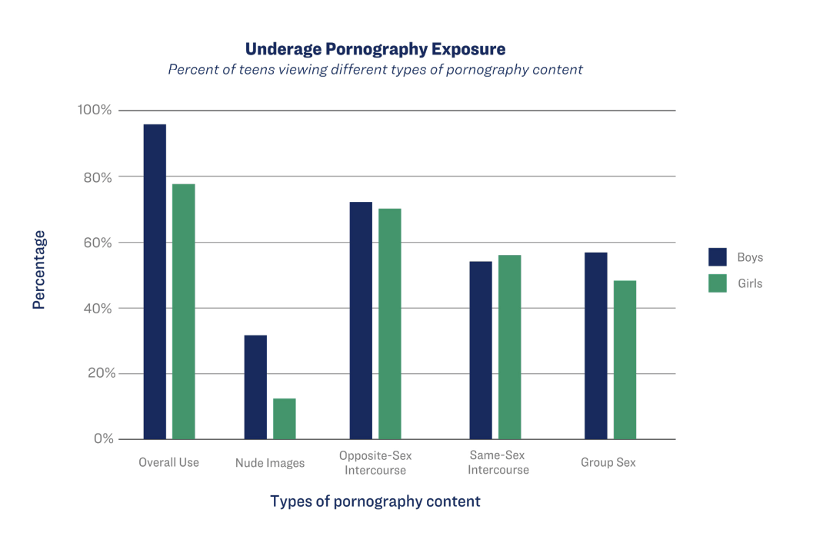

Slide 7
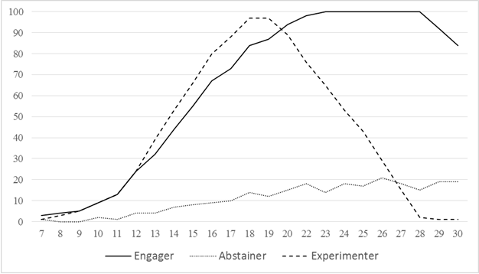
Trajectories of Use Through Adulthood
Largest Group (42%)

Slide 8


What does it all Mean???
Facts:
  Pornography remains one of, if not the most common risk behavior youth and young adults are engaged with.
  Almost all youth and young adults have seen pornography
  However, most use begins to dip into adulthood or stays low.
But, let’s dig a little deeper into what this use is like among religious populations….

Slide 9
Young Adults (2016) U.S. data
 | Every viewed pornography? |  | Viewed pornography in the last 12 months? (of those who have ever) |  | How Often?(among users)
 | Yes | No | Yes | No | Daily/Weekly | Monthly | Yearly
LDS men | 81% | 19% | 73% | 27% | 13% | 32% | 55%
Catholic men | 96% | 4% | 90% | 10% | 42% | 39% | 19%
Protestant men | 93% | 7% | 91% | 9% | 49% | 30% | 21%
Other/None men | 92% | 8% | 95% | 5% | 49% | 34% | 17%
LDS women | 24% | 76% | 43% | 57% | 2% | 11% | 87%
Catholic women | 83% | 17% | 81% | 19% | 13% | 20% | 67%
Protestant women | 81% | 19% | 67% | 33% | 21% | 17% | 62%
Other/None women | 81% | 19% | 80% | 20% | 16% | 31% | 53%

Slide 10
Religious Males
16%
20%
7%
38%
35%
Never
Weekly
Daily
Monthly
Yearly
Non-Religious Males
11%
44%
20%
28%
5%

Slide 11

What are the numbers telling us about religious individuals?
Religious men:
  Similar trends in overall teenage use and overall use by year with non-religious men
  Frequency rates are generally lower
    Monthly/Yearly vs. Weekly/Daily
  Pornography use is normal among most religious men
    Normal vs. healthy
Religious women:
  Most unique group
  Likely engaging in proactive efforts to avoid use
Both groups report high levels of anxiety and uncomfortableness talking about this issue
What happens when these two groups try to date?

Slide 12
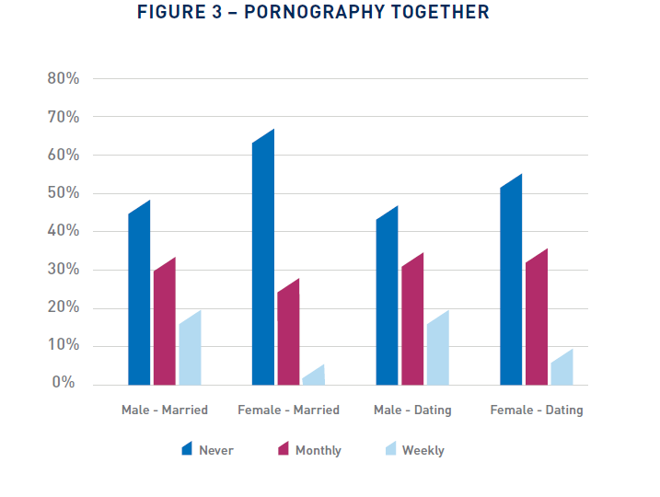

Slide 13
Is Pornography Use Having any Effect on Youth?
Yes, but in a complicated way

Slide 14

Pornography Effects (part 1)
No use or sporadic use (common):
  Little evidence of effects
Occasional use (common):
  Shifting views and expectations of intimacy (scripts)
  Increased possibility of conflict/struggles in intimate behavior
    Lower relationships satisfaction
    Lower sexual satisfaction
    Especially true of male use

Slide 15
Males: In Committed Relationships

Slide 16
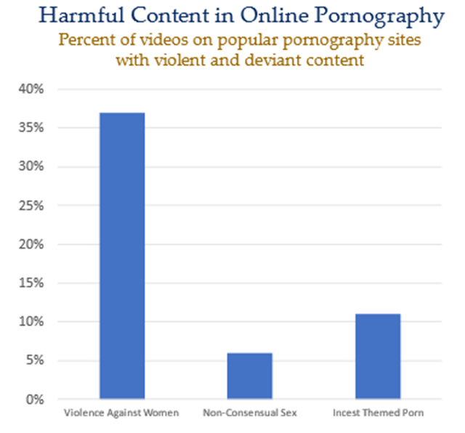
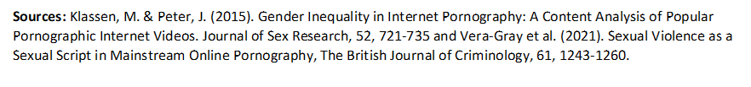

Slide 17
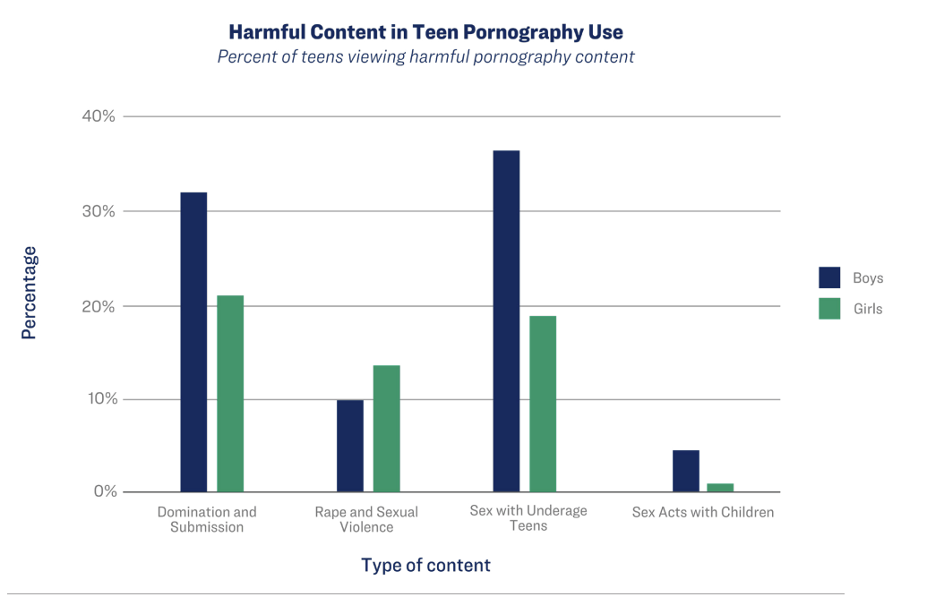

Slide 19
Relational Costs of Pornography
What are the relational costs of occasional pornography?
  Short-term
    Shifting scripts (expectations about sex)
    Triple NNN
      Non-normative people
      Non-normative behaviors
      Non-normative context
  Long-term
    Marriage is impacted by pornography use
Pornography
Script
Sexual intimacy is about connecting with my partner physically, emotionally, spiritually (Sexual Wholeness)
Sexual Intimacy is about my sexual needs with a sexually available and often submissive partner
Intimacy
Frustrated, individualistic, and selfish behaviors
Engaged, empathetic, and enthusiastic behaviors

Slide 20

Pornography Effects (part 2)
Compulsive and addictive behavior (rare but elevated in clinical populations):
  Lower mental health
  Shifts in brain chemistry
  Links to risky sexual behaviors
Little to no research evidence that pornography:
  Increases the likelihood of sex offending
  Increase in arousal problems (ED)

Slide 21
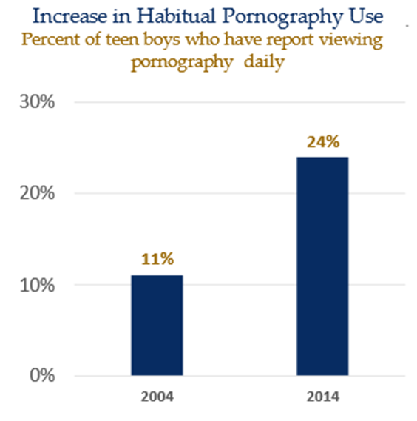

Slide 22
Depression by Pornography Use
(Young Adult Females)

Slide 23
The Issue of Age of Exposure

Slide 24
The Issue of Age of Exposure

Slide 25
The Issue of Age of Exposure

Slide 26
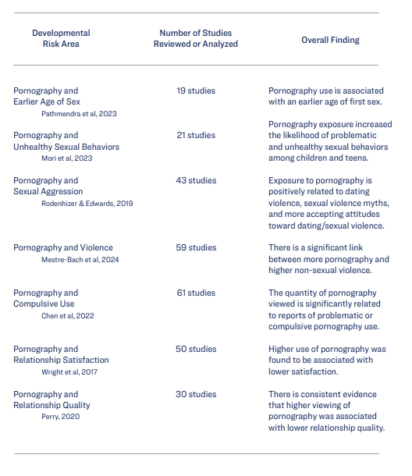

Slide 27
Is Porn Just a Problem for Religious Youth?
Mostly No (see previous material)…But in Some Ways, Yes

Slide 28

Pornography In Religious Cultures
Pornography is an elevated problem among religious couples:
  General sexual anxiety
  Elevated fear
  Cultural myths
Net Result: Negative outcomes are often elevated and exaggerated in religious cultures
  Moral Incongruence
  Perceived Addiction
Fear about pornography appears to create a self-fulfilling and negative cycle of behavior among religious couples and individuals

Slide 29
340% Increase over actual estimate

Slide 30
Reports of Pornography Causing Conflict in my Relationship – U.S. Data, Actively Religious

Slide 31
20% Higher

Slide 34
The Future? AI and Deepfake Technology
Emerging generative AI technologies are now adding a new wrinkle to online sexual spaces for teens

Slide 35
AI as Romantic/Sexual Partner Simulation

Slide 36
18-30 Year Olds, U.S.

Slide 37
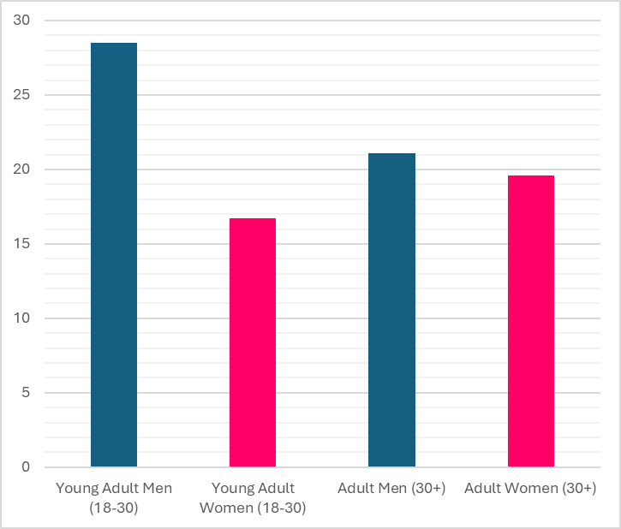
Prefer AI Relationships Over Real Relationships
Percent in agreement with the statement:
“I would rather communicate with an AI based program than engage with a real person in a relationship”

Slide 38
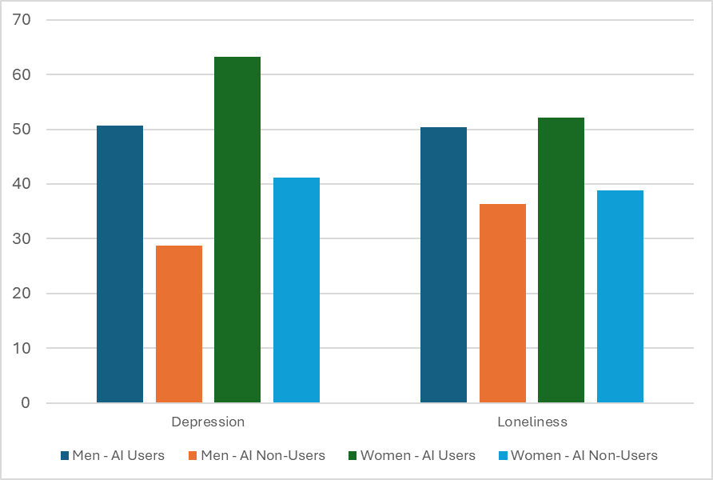
AI Relationship Technology and Mental Health
Percent reporting risk of depression and loneliness among users and non-users of AI relationship technology

Slide 39
What are the current needs of youth?
Better resources for pornography use at all levels.
Better media and digital literacy for youth and parents.
Better communication resources for parents and better healthy sexuality resources for families
Better intervention aimed at youth

